Slide 1

Sales Forecast System
Student Name: Chen Tao, PAN HUAIXIAN, Hu Na
Student ID: 0353798, 0351649, 0353741

Slide 2

Problem Statement
Our project uses a challenging time series dataset consisting of daily sales data provided by 1c company. The ultimate goal is to help 1ccompany solve the sales forecasting problem and thus help 1c company to better apply the model proposed.
To help 1c-company with their sales forecasting, so the context of our goal is to create a robust model that can handle time series data for price forecasting, while ensuring the application of the model and the collection of data and repetition of the training model. The problem will therefore focus on three areas: data processing, model building, and model evaluation.

Slide 3
Objectives
The clear understanding of the procedure of a sales forecast and different evaluating tools
Dimensionality reduction of datasets, grouping by features
Create multiple models and evaluate them to select the best one
Create web application to help companies make better sales forecasts

Slide 4

Dataset
Dataset Descriptio
To estimate the following month's total sales for every product and shop. By participating in this contest, we will show to utilize and improve our data science abilities.
The data are given daily historical sales information. The assignment is to estimate the total number of goods sold in each store during the test set. Note that the list of stores and items varies significantly each month. Developing a model capable of handling such circumstances is part of the difficulty.
Data Fields
* shop_id - unique identifier of a shop
* item_id - unique identifier of a product
* item_cnt_day - number of products sold. Predict a monthly amount of this measure.

Slide 5
Processing

Slide 6
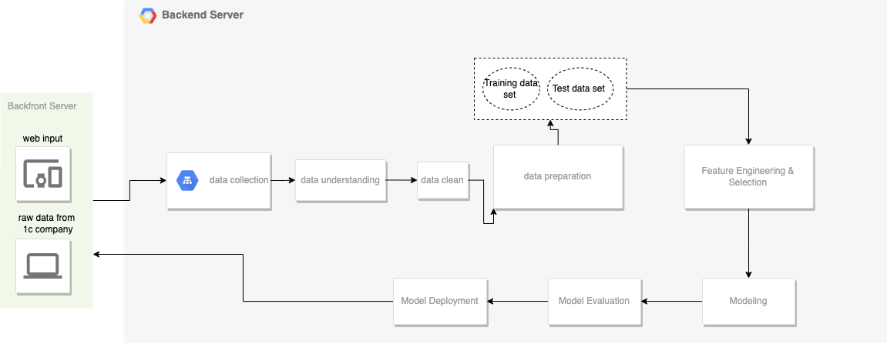
Architecture

Slide 7
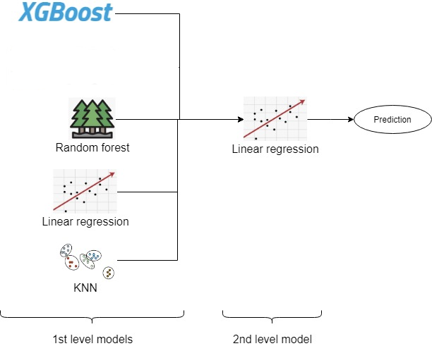
Ensemble Model

Slide 8
Result & Evaluation
Evaluation:
RMSE

Slide 9
Future Work
Spark parallel process
Time series Analysis

